Slide 1


INTERACTIVE CROP SEASON DASHBOARD
A Prototype for Monitoring Food Security Across Karamoja Districts and Sub-Counties

Slide 2

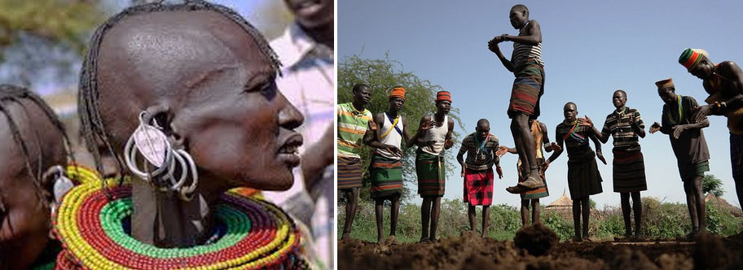
PROBLEM STATEMENT
Karamoja, the most food-insecure region of Uganda, suffers from low crop productivity due to severe droughts and pest outbreaks. NGOs provide support to farmers with low yields but lack comprehensive regional data, relying instead on local sources to prioritize their efforts.

Slide 3



OBJECTIVES
The main objective is to develop a new food security monitoring tool to support the decision-making of NGOs active in Karamoja
Develop an Interactive Tool
Data Visualizations
Provide Initial Mockup
Support Decision-Making

Slide 4
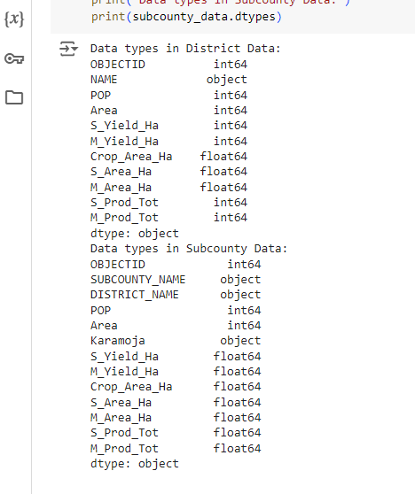
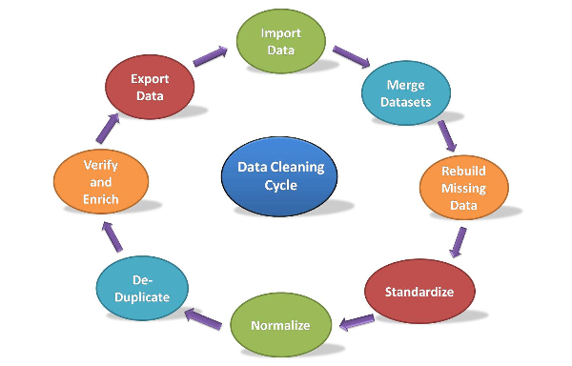


CLEANING AND PREPARING DATA FOR VISUALIZATION
The process entailed removing duplicates, handling missing values, and standardizing formats; for example, ensuring all population figures are consistently in the same unit of measure and data types.
Then after exported data to visualize using Tableau

Slide 5

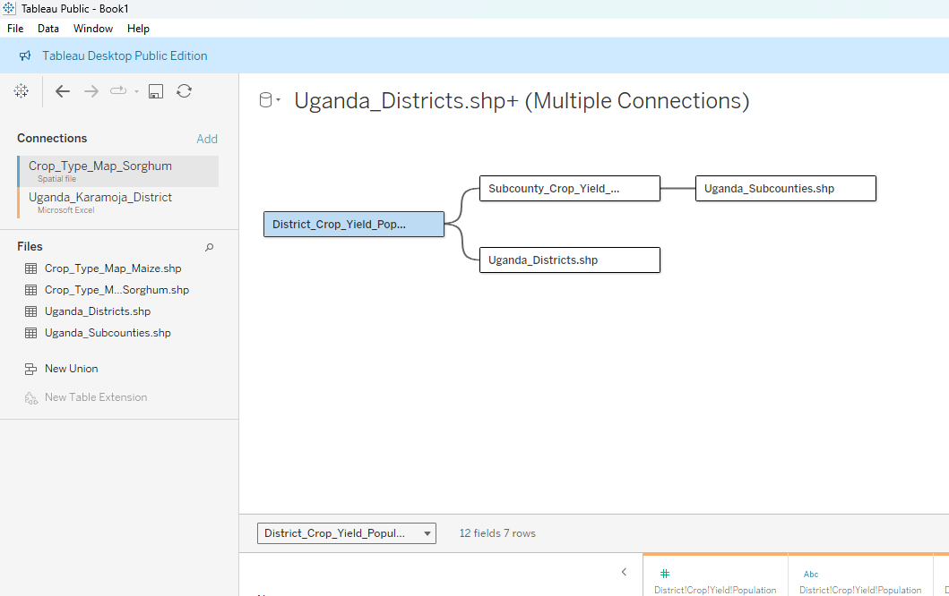
DATA ANALYSIS & VISUALIZATION
Connected to data in Tableau
Choose the appropriate data source which includes; "Excel" for CSV files and "Spatial File" for shapefiles.
Set up relationships by using the OBJECTID column, which appears in both tables as a unique identifier. The NAME and DISTRICT_NAME columns, representing district names, are also present in both tables.
OBJECTID was also used as the Primary Key in both table, establishing a connection between the tables and the spatial data.

Slide 6
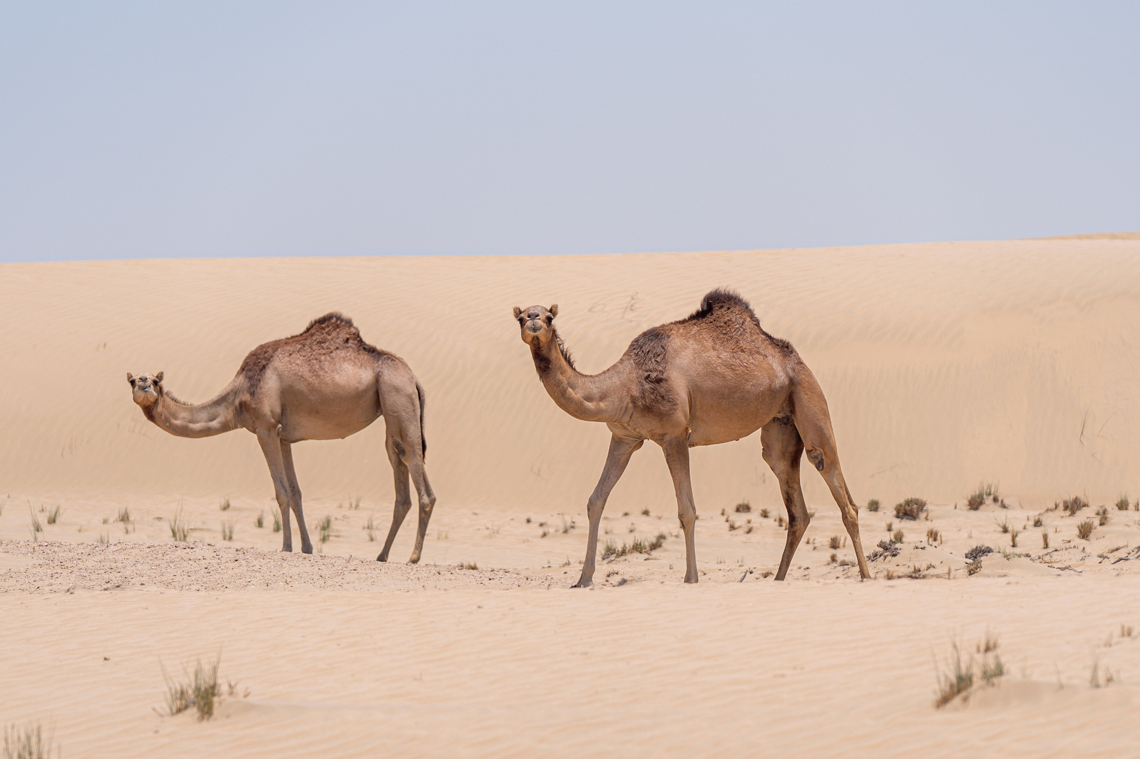
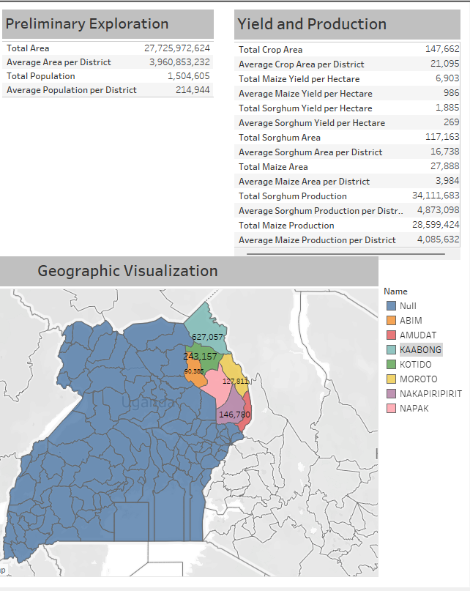
PRELIMINARY EXPLORATION
The goal of preliminary exploration is to identify patterns, trends, or anomalies that may warrant further investigation
This step involves looking into key statistics, such as totals, averages, and to get a sense of the overall distribution and scope of the data
Total Districts: 16
Total Subcounties: 32

Slide 7
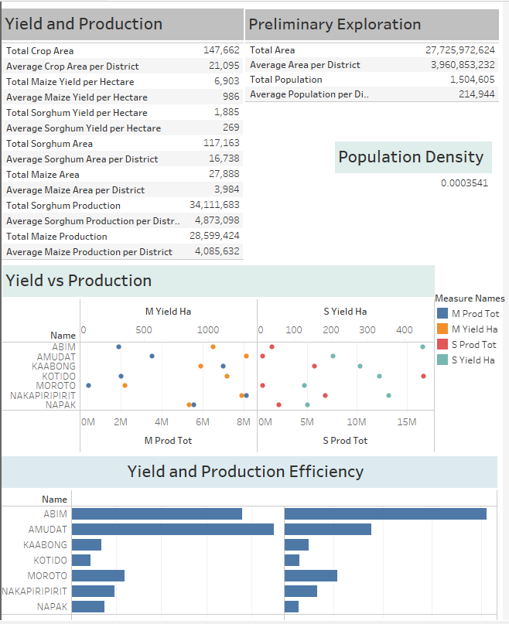

YIELD AND PRODUCTION
DISTRICT LEVEL
High Yield vs. High Production: Districts like AMUDAT, KAABONG, KOTIDO, NAKAPIRIPIRIT, and NAPAK show high production values, with NAKAPIRIPIRIT and KOTIDO having particularly high production despite varying yield levels. Due to large cultivated areas, KAABONG and KOTIDO achieve high production with moderate yields.
Low Yield Impact: Districts with low yields, such as ABIM and MOROTO, tend to have lower overall production figures. However, ABIM's production is bolstered by a substantial area under cultivation.
Districts exhibit significant differences in yield between seasons. The M_Yield_Ha season often shows higher yields compared to S_Yield_Ha, impacting the total production.
From the data higher production is associated with larger cultivated areas and, in some cases, better yields, but even moderate yields can result in substantial production if the area is large enough

Slide 8

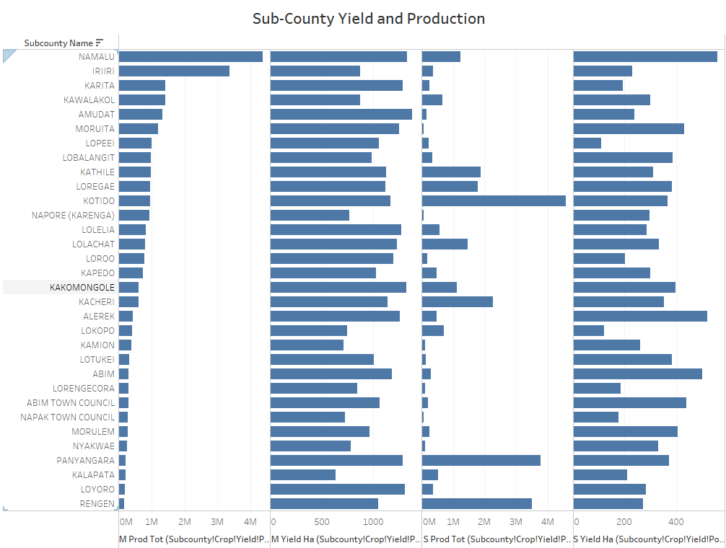
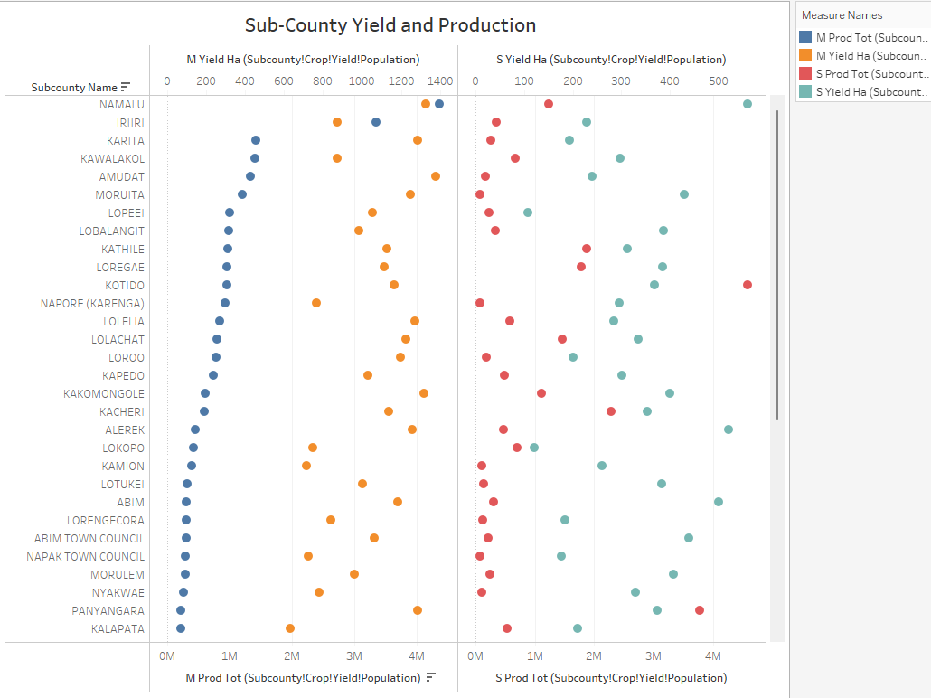
YIELD AND PRODUCTION
SUB-DISTRICT LEVEL
There are sub-counties within Karamoja that stand out with higher production figures. For instance, PANYANGARA and RENGEN report some of the highest production levels, indicating that while average yields might be low, certain areas have managed to achieve impressive production outputs.
Moving to the Kaabong District, the data reveals a diverse range of yields and production levels. Subcounties like KAWALAKOL and KATHILE exhibit particularly high production figures. This variation suggests that while the overall performance might fluctuate, there are specific areas where agricultural practices or conditions lead to significantly better outcomes.
In the Moroto District, the trend shows generally lower yields across most subcounties. However, this district still sees high production in certain areas, such as RUPA. This indicates that even with lower yields, effective crop management or larger crop areas can still lead to substantial production totals.

Slide 9
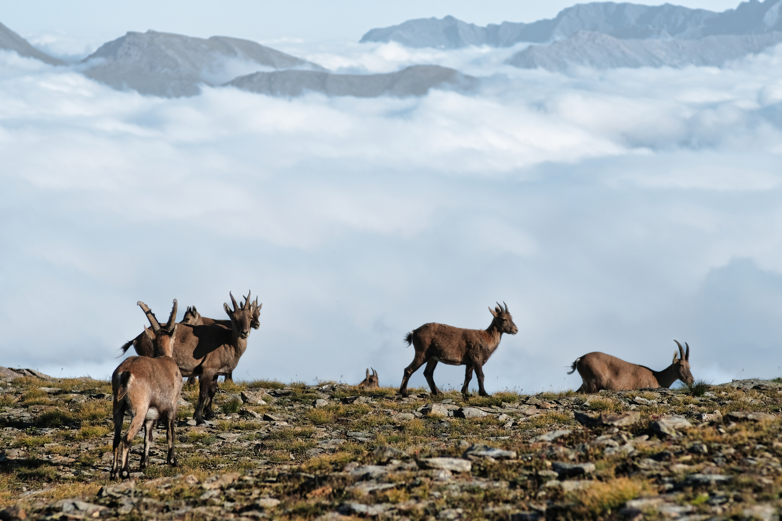
CONCLUSION AND BUSINESS RECOMMENDATIONS
Conclusion:
The analysis of agricultural performance across districts and sub-counties in the Karamoja region reveals significant variability in crop yields and production levels. The key drivers of success appear to be effective land use and crop management practices, which allow these some areas to achieve higher productivity despite regional constraints.

Slide 10

BUSINESS RECOMMENDATIONS
Targeted Agricultural Support Programs:
Expand successful practices: Agricultural practices from high-performing sub counties like NAMALU and KAWALAKOL should be studied and promoted across other regions. Providing training and resources to replicate these methods in lower-performing areas could boost overall regional productivity.
Focus on Land Use Optimization:
Improve crop area management: Given the significant impact of effective land use on production, there should be a focus on optimizing the crop areas in underperforming regions. This could involve land rehabilitation, better irrigation practices, or the introduction of high-yield crop varieties.
Resource Allocation and Investment:
Invest in low-performing sub-counties: Areas like SOUTHERN DIVISION and NORTHERN DIVISION in Moroto should receive targeted investments, including improved agricultural inputs, infrastructure, and extension services, to address the specific challenges they face and uplift their production levels.
Scale Successful Interventions:
Broaden successful initiatives: Programs that have proven successful in sub-counties with high yields and production should be expanded to neighboring districts. This includes promoting high-yield seeds, better pest management, and modern farming techniques.
Monitoring and Continuous Improvement:
Establish regular monitoring: Regular monitoring of agricultural performance across all sub counties should be implemented to track progress, identify emerging challenges, and continuously adapt strategies. Data-driven decisions will ensure that interventions remain effective and resources are allocated efficiently.

Slide 11

Future Work
1. Temporal trends in crop yields and production.
2. Impact of socioeconomic factors on agricultural outcomes.
3. Predictive modeling for future crop yields and production.
4. Impact assessment of agricultural interventions.
5. Supply chain and market access analysis.
6. Environmental impact of current agricultural practices.

Slide 12
Conservation
Studying habitats allows us to identify and understand the threats they face. Human activities, such as habitat destruction, pollution, and climate change, can harm habitats and the organisms that depend on them. By studying habitats, we can work towards conserving and protecting these fragile ecosystems.

Slide 13



THANK
YOU!

